Slide 1

HCI - Assignment n.2
EZStand - The Easy Way of Buying a Car
Group - Bruno Pinto(73156) / João Vasconcelos(89022)
Lab Class - P6

Slide 2
Introduction
EZStand
We had a debate with a friend that was searching for a car to buy
After thinking about the state of car sales and the way the sale is conducted, from the search of the client for a car that suits him to the point the client pays for the car, we reached the conclusion that must be a way to simplify the process
After thinking for a while an idea of an easy application to search cars to buy was thrown at the table and EZStand was born
This will be a stand-alone project, so it will not have any relation with other courses

Slide 3
Project Objectives
EZStand
We expect that the users will find that car the suits their interests through or app, without visiting multiple stands with no results
By doing a good choice of the requisites on the application , saves time and prevents confusion in the moment of buying the car
Make a good application that allow stands to advertise their cars through it
That application will also have a good and intuitive design , to make an easier experience to every types of user

Slide 4

Personas
EZStand
João
João is a 25 year old man from Viseu. He works as a software developer at a company in Lisbon since he was 22 years old. He studied in Aveiro, where he got his graduation in computer science at age 21.
Since a few months ago that João thinks about purchasing a new car. Because of his parents living in his hometown and his local work being far from his residence. However, he does not pretend to spend a lot of money so he prefers a car in second hand.
João also works 8 hours a day, and going car stand by car stand would be very exhaustive. An app that would gather all the stands around him would be great for his problem.

Slide 5
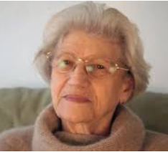
Personas
EZStand
Maria
Maria is a 75 year old women from Santarém, mother of 2. She used to work as a nurse in her home town and is now reformed.
Maria is reformed since she was 65 and she is not a very adventurous women, so she usually does not spend her savings on travelling or expensive stuff.
Because Maria has a lot of money saved she wants to offer a car to her grandson Manuel. EZStand would help her a lot since Maria does not have a license car of her own, so looking at cars at home would be perfect for her situation.

Slide 6

Personas
EZStand
José
José is a 40 year old man, with his own car stand at Porto. He has 2 sons and both are in college.
José has not been making much money lately because not as many people visit his stand anymore. So sustaining both of his sons is getting difficult.
An app like EZStand would be life saving for his situation, since he would have more exposure, and more people would start buying the cars he has for sale.

Slide 7
Scenarios
EZStand
Scenario #1
João wants to buy a car in second hand, but he does not have time to visit car stand by car stand. So, he decides to use the app EZStand in the comfort of his house.
After João opens the app, it is presented a list of cars for sale near his location as well as an intuitive system of search that let's him filter cars by brand, price and others.
When he already has an idea on what car he pretends to buy, João calls the respective stand and schedules a date so he can meet an employee that works on the respective stand where the car is at.
After the call, the seller can go to his account and edit the car description marking it as reserved.

Slide 8
Scenarios
EZStand
Scenario #2
Maria bought a car to her grandson Manuel.
As she is very satisfied with her purchase Maria decides to rate the Stand where she bought the car from as a 5 out of 5.
This will take effect in the average rating of the stand, and it will show for all the users in the app

Slide 9
Scenarios
EZStand
Scenario #3
José wants to add his stand to the app.
After creating an account as a stand owner by verifying the location, he can add each car one by one.
For each car he needs to upload a photo and tell the characteristics (brand, year, km etc)

Slide 10
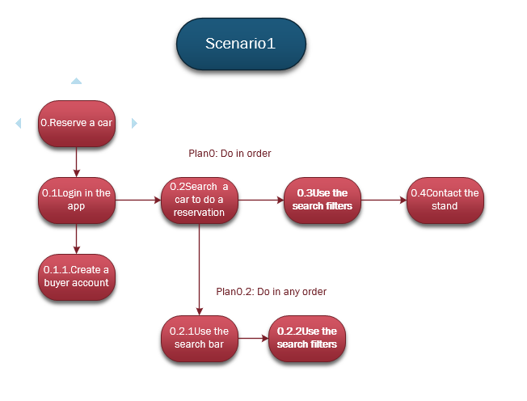
Tasks
EZStand
This is an example of a task that becomes that you can perform with the application
This is a task that is much easier doing through the application instead of visiting multiple stands
If the user does not have a smartphone, don’t know how to work with one or has access to Internet, he will not be able to use the application

Slide 11
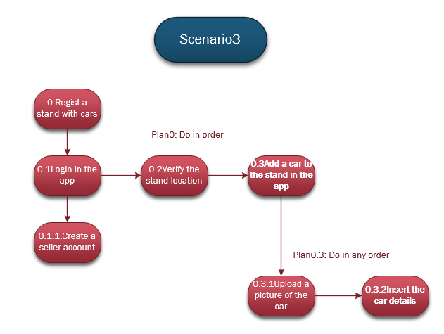
Tasks
EZStand
This is an example of a task that becomes that you can perform with the application
This is a task that is much easier doing through the application instead of visiting multiple stands
If the user does not have a smartphone, don’t know how to work with one or has access to Internet, he will not be able to use the application

Slide 12

Requirements
EZStand
Allow users to see a car details, including the stand contact number in case they want to contact them
Allow the making of a search for cars with filter based on brand, price and location of the stand (for example: to be possible to search for all BMW's in lisbon, that cost 5000 euros or less and organize by order of ratings of the stand where the car belongs to)
Allow the making of a search of stands with filter based on location and rating of the stand as well as popularity (for example: to be possible to search all stands available in Aveiro and organize by order of ratings or popularity of each stand)
Allow a user to see all cars available on a specific stand (for example: see all cars available to buy on stand X)
Allow the user to rate the stand after the reservation of a car
Allow an user that manages a stand to add, edit or remove a car
Allow an user that manages a stand re-add a car to the stand after it being removed

Slide 13
Non-functional Requirements
EZStand
Low responsive time to complete a given task (loading data)
Usability (user should understand the flow of the App easily)
Reliability (when a user performs an important task, like making a reservation, it should be acknowledged with confirmation)
Security (authentication on log-in)
Screen adaption to device size
Availability (app is available to download from app store or play store, user should be able to rate the app and contact necessary person via app (help tab))

Slide 14

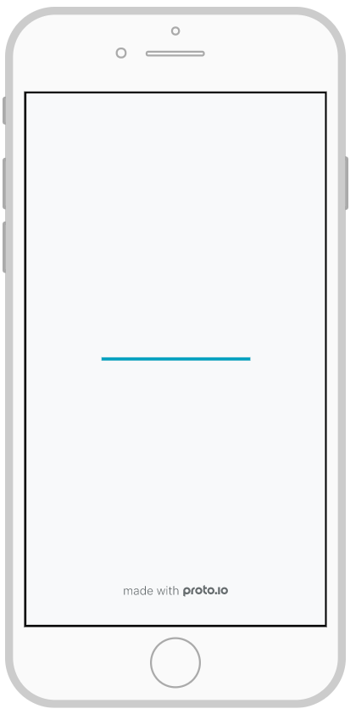
Low Fidelity Prototype
EZStand
Digital prototype made in Proto.io
Main Features
Buyer Interface:
Create Account and Log In method
Searching a car by search bar or using filters
See available cars from a stand
Rate a Stand
Seller Interface:
Add/Remove/Edit a car from a seller stand
Create Account and Log In method
See history of removed cars as well as having an option to re-add a car from that history

Slide 15
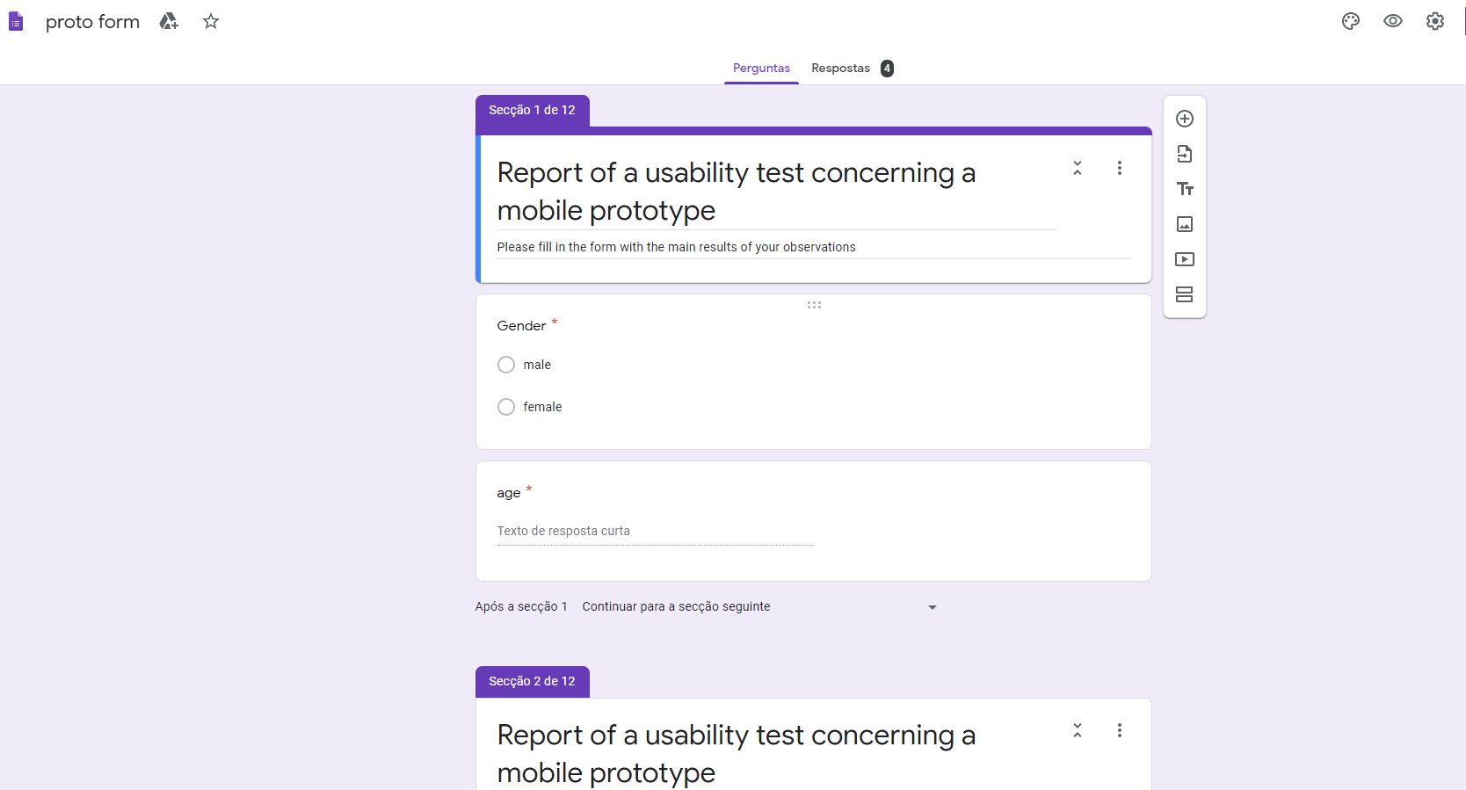
LFP User Evalution
EZStand
The evaluated were 2 females and 2 males, ages between 20 and 50
They each performed 10 tasks and gave an overall opinion and suggestions about the prototype
USABILITY TESTS
For the Client:
Create account
Give Rating to a Stand
Observe the Cars of a Stand
Observe the description of a car
Log in and log out from the app
For the Seller:
Create account
Add and Edit a Car
Remove a Car
Re-add a Car
Log in and Log out from the app
Main Results
All the evaluated completed all the tasks, with most of them being easy, but some like, evaluate a stand or edit a car, were specially more difficult

Slide 16


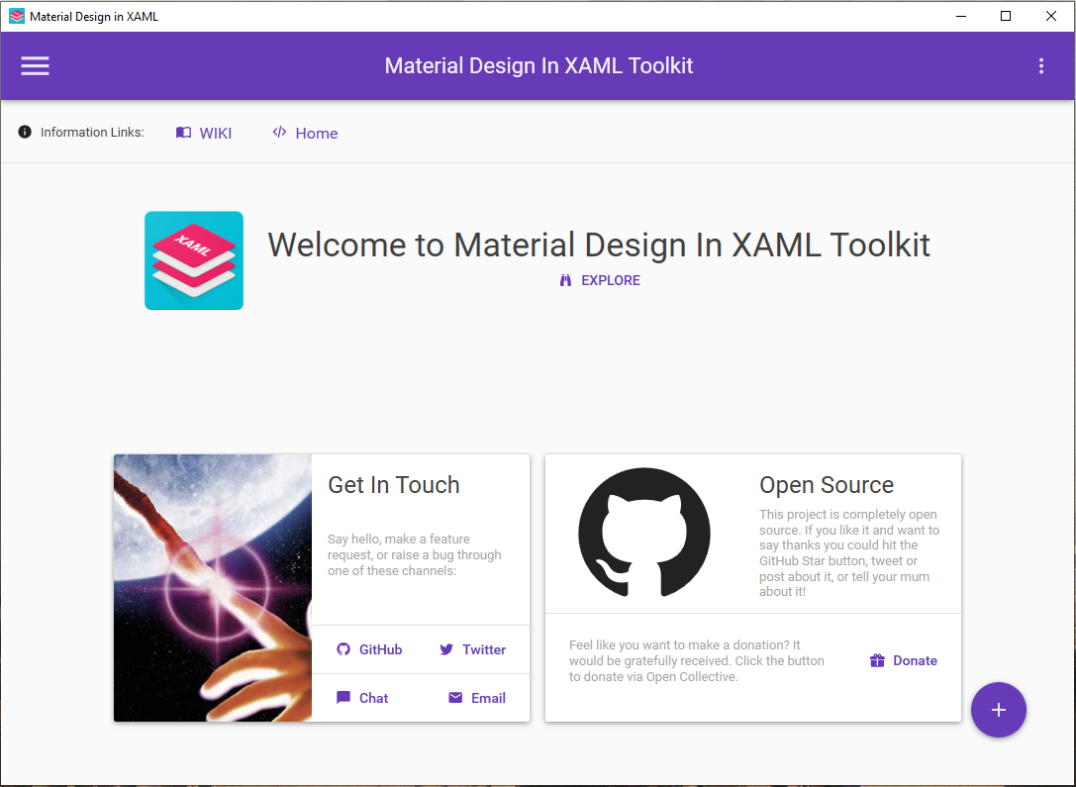
Platform used For the Functional Prototype
EZStand
Main tools Used
C#
Visual Studio (WPF)
Main Library Used
Material Design In Xaml ToolKit
No specific hardware used besides our personal computers

Slide 17

User Evaluation of the Functional Prototype
EZStand
The evaluated were 2 females and 4 males,
ages between 20 and 50
Results were overall better than the prototype
evaluations (no questions were asked by the users
during any of the tests, all tasks were completed correctly)
Only one more task was given
(change accounts settings)
1 User suggested implementing a database, the other 5
had no comment on additions to be made to the app
USABILITY TESTS
For the Client:
Create account
Give Rating to a Stand
Observe the Cars of a Stand
Observe the description of a car
Log in and log out from the app
Change account settings
For the Seller:
Create account
Add and Edit a Car
Remove a Car
Re-add a Car
Log in and Log out from the app

Slide 18
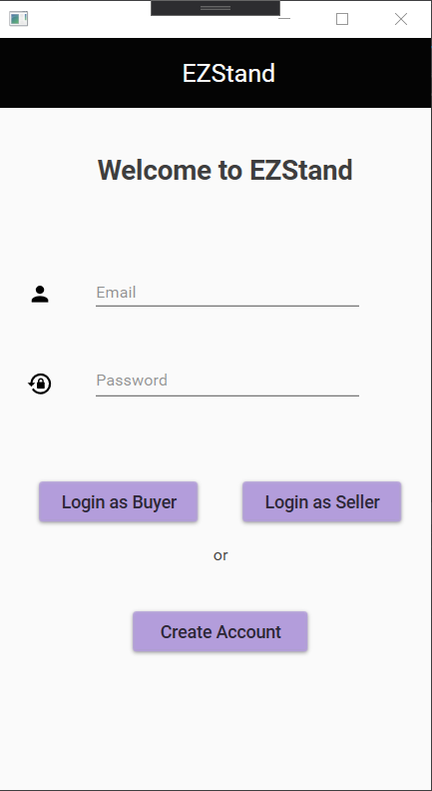
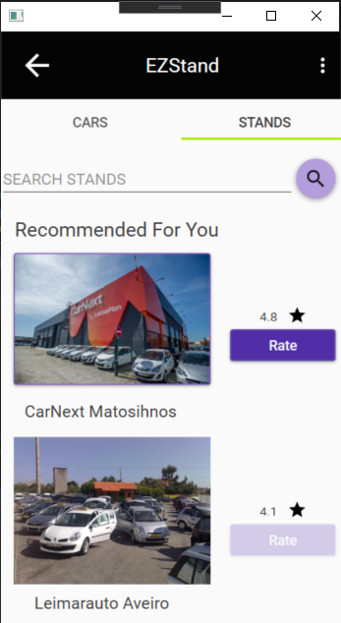
Demo
EZStand
Buyer Interface:
See available cars as well as their description
See available stands
See available cars from a certain stand
Rate a stand
Seller Interface:
See own cars
Add/Edit/Remove a Car
See available cars from a certain stand
See all the cars removed as well as having an option to re-add them
Both:
Authentication system
Searching a car by search bar or using filters

Slide 19

Future Work
EZStand
Implement a way to see more photos of a selected car or stand
Implement a DataBase
Support videos of a stand or a car
Add a history tab to the buyer interface as well as a favourites tab for both stands and cars
Accept and create a section for stands that sell motorcycles

Slide 20

Acknowledgments
EZStand
We want to thank our teachers for the classes and the help, our classmates for the tips and all the participants of the prototype and the app evaluation
Effort of each group member
Bruno Pinto - 50%
João Vasconcelos - 50%

